Slide 1

Tips and Tricks for Making Good Publication Maps
Chris Anderson “Opie”
Chris.Anderson@MyFWC.com

Slide 2
Caveat
There are exceptions to every suggestion presented here.
Size, fill, outline, font, etc. depend upon the map and how it is to be used
This presentation is focused on peer-reviewed publications printed in black and white.

Slide 3
Work backwards
Is it black and white or color?
What size will it be printed?
2 columns, quarter page, half page, etc?
Choose a map orientation to match the orientation of the shoreline and data.
East-to-West – landscape
North-to-South – portrait
Florida - square
What file format is needed by the publisher? Raster (TIFF JPEG)? Vector (PDF, EPS, Adobe Illustrator)
Answer these types of questions before even starting your map.

Slide 4
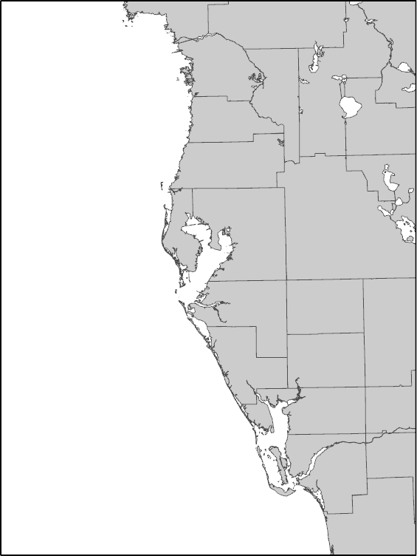
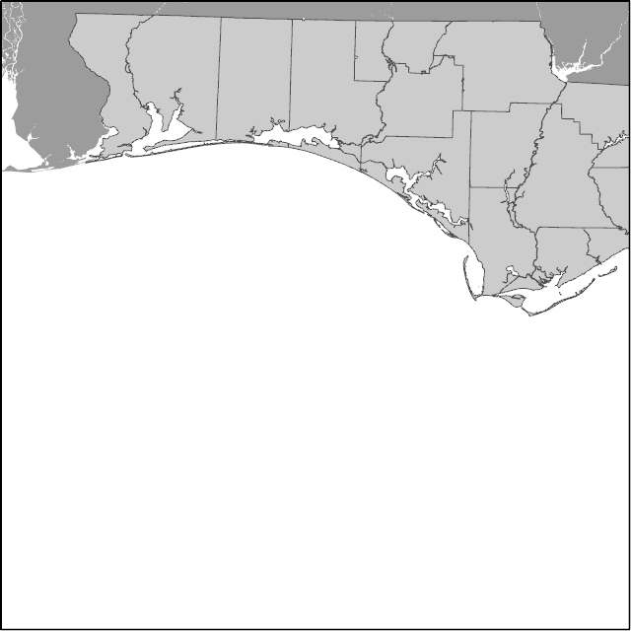
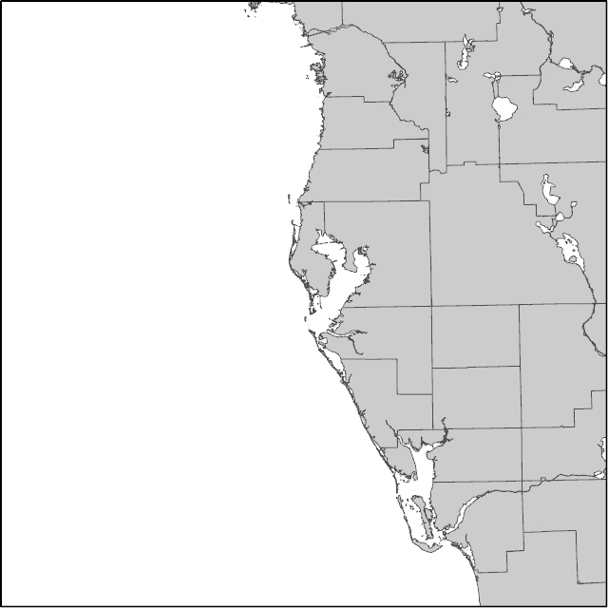

Slide 5
Map Set-up
Draw the map out on paper before you write one command.
Write down what data sets you want to show.
Write down what labels you need to show.
Land, hydro, specific labels
Only show those that are pertinent to the map.
Intellectual hierarchy
Important information is highlighted and shown on top of ancillary information.

Slide 6
Map Set-up
Set your page size to the actual size the map will be published.
Don't be afraid to rotate the map to maximize the area of map shown.
Use the appropriate shoreline to the map.
No need to use super detailed shoreline for mapping a large area.
100K shorelines are good for general, statewide maps
40K for more detail
12K for high detail

Slide 7
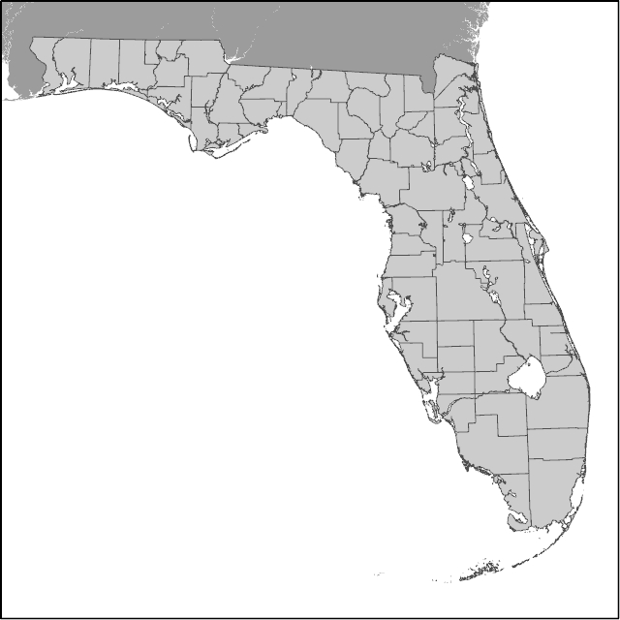
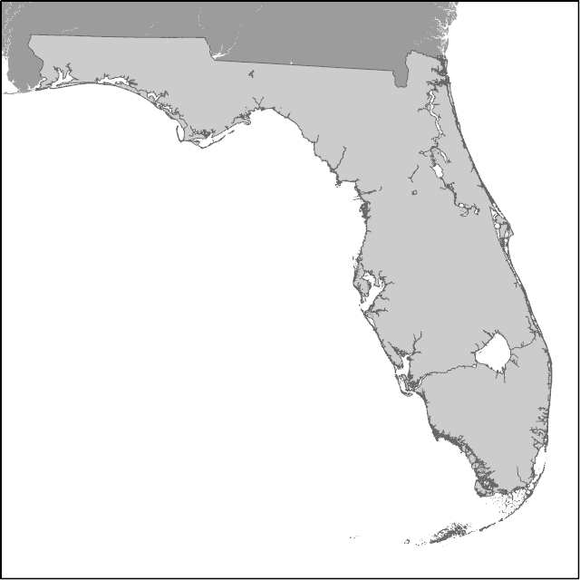

Slide 8
Map Set-up
Land color - 20% gray fill, Outline - 60-70% gray, .5 pt wide
Water – No fill
Don't forget to show GA, AL, and MS if all of Florida is shown.
FL is not an island
70% gray, no outline

Slide 9
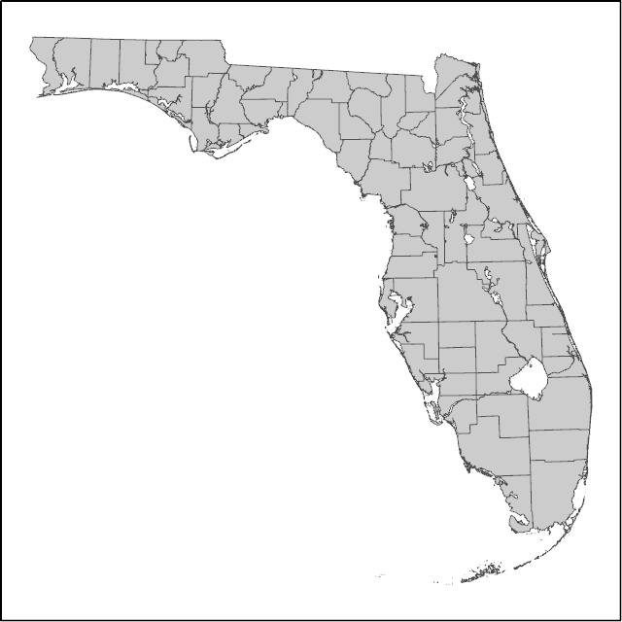

Slide 10
Data Display
Follow the K.I.S.S method.
Include one or two data sets other than shorelines.
Show data with as few categories as possible.
Usually one
If you can’t show data simply then consider a color map or multiple maps.

Slide 11
Data Display
Polygons
Solid fill only
No patterns
No outline unless absolutely necessary
Lines
Variable line width can be used
Pattern can also be used

Slide 12
Data Display
Points
Size of points should be similar size to map text
Can range from single-color, single shape to black and white character symbols
Unfilled symbols are discouraged

Slide 13
Data Display
Map Text
Should be proportional to the text size used for a letter-sized Word document
8-14 pt
Important text should be larger than less important text
Physical features should be in a serif font.
Times, Garamond, Century Schoolbook
Data features should be in a sans-serif font
Arial, Helvetica, Franklin Gothic
Water features should be italicized

Slide 14
Marginalia
Marginalia are all the extra stuff around the map.
Should only be seen if you need to look for it.

Slide 15
Marginalia
Graticules and coordinates
Graticule labels should be parallel to the side of the map they are located.
Keep distance between lines of measurement (e.g. lat/lon) consistent for both axes.
Based upon map size and scale
Labels should be proportional to map text.

Slide 16
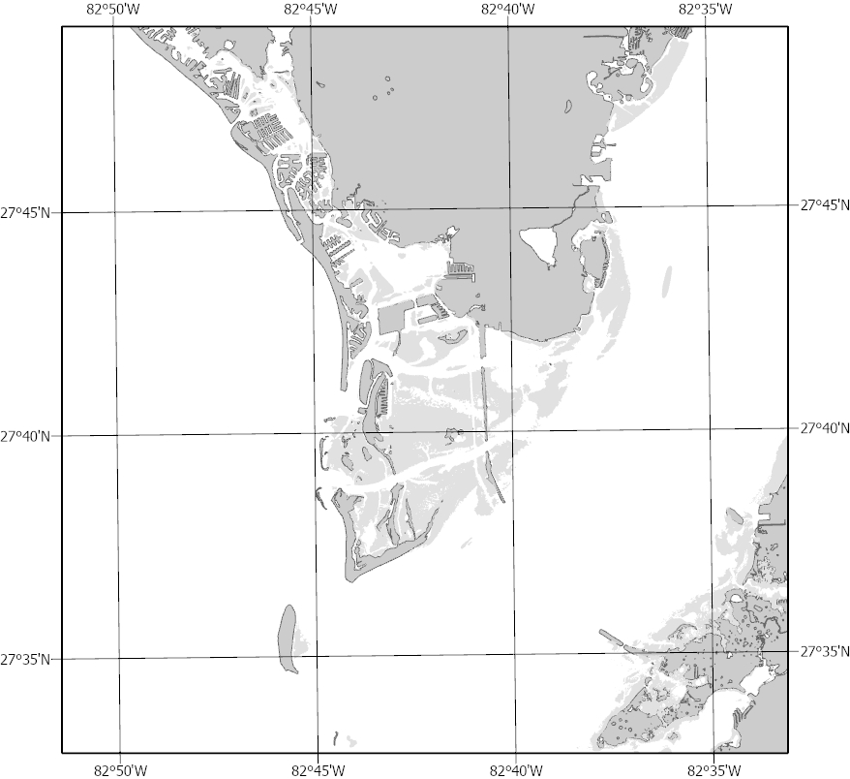
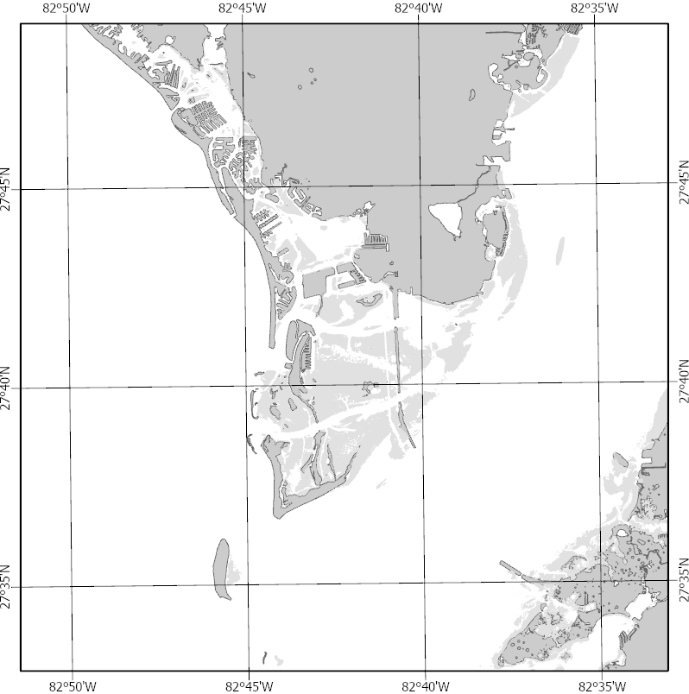

Slide 17
Marginalia
Scalebar
Should be proportional to map scale
Alternating scalebars
If scalebar begins with a solid, should end with a solid.
3 or 5 divisions
Unless needed, do not make sub-divisions
Units are top center
Only divisions are labeled

Slide 18
Marginalia
North Arrow
Fonts are available with north arrows as characters.
Font - ESRI North Regular
Character - ESRI North Arrow #2
±
Proportional in size to the map size, text size, and scale bar

Slide 19
If you have any questions, or would like your map reviewed, please let me know
Phone – 727-502-4856
E-mail – Chris.Anderson@myfwc.com

